Slide 1

Doubling Down on Cooking Metaphors: SaaS PaaS & IaaS at WWU
Jon M. Junell

Slide 2
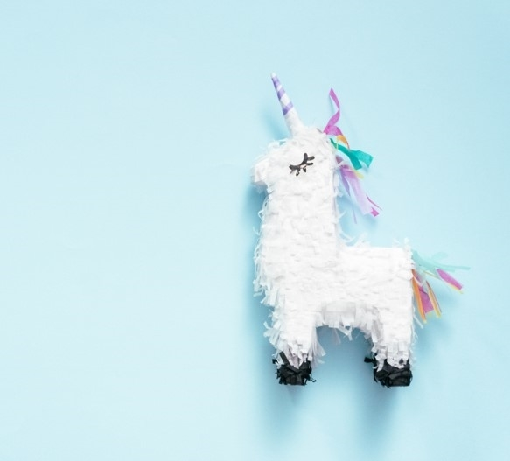
Agenda
Why are we talking about this?
History
As A Service, and the Pizza Stack
IaaS
PaaS
SaaS
Today

Slide 3
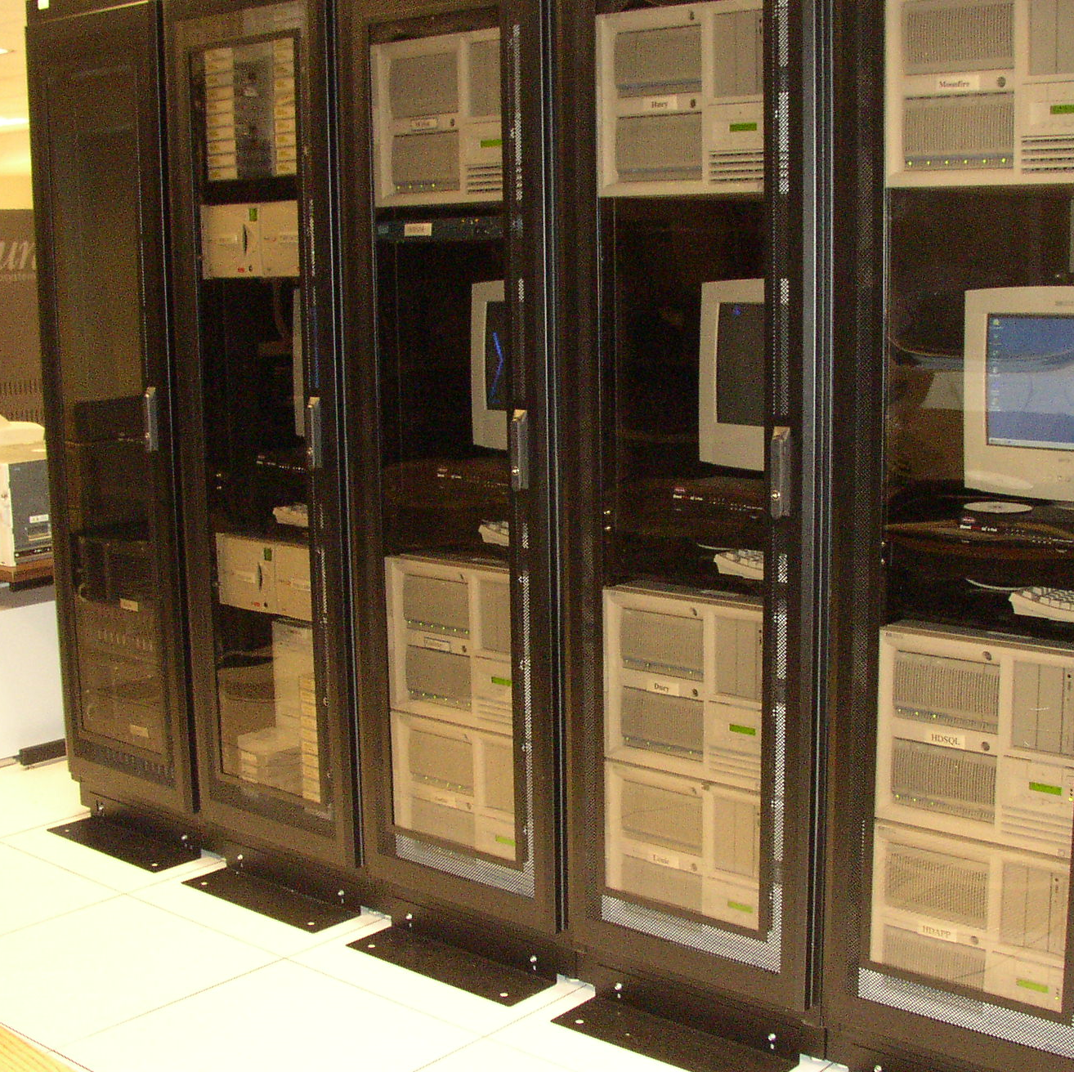
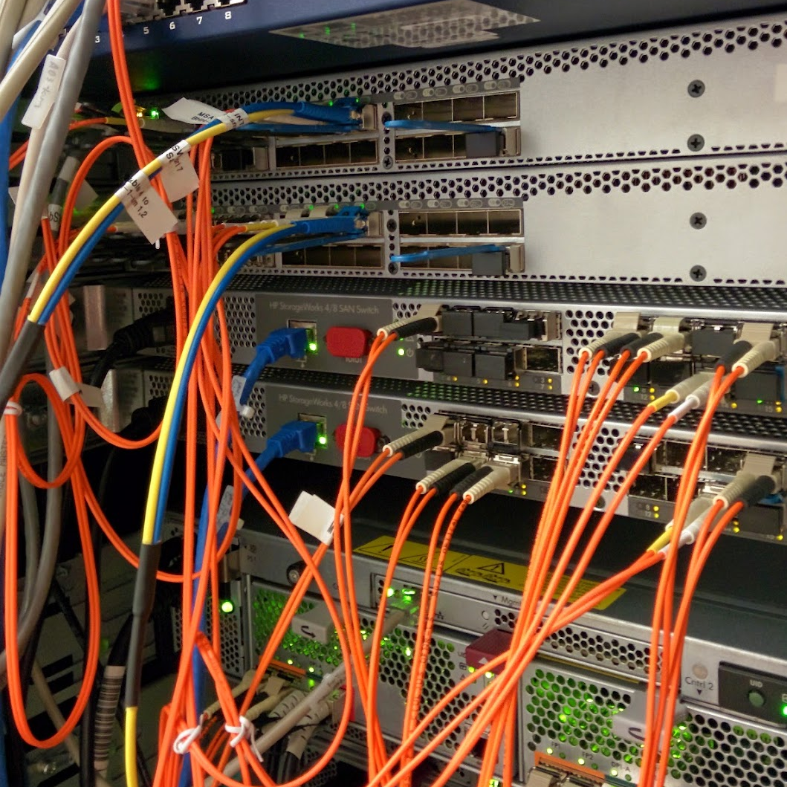
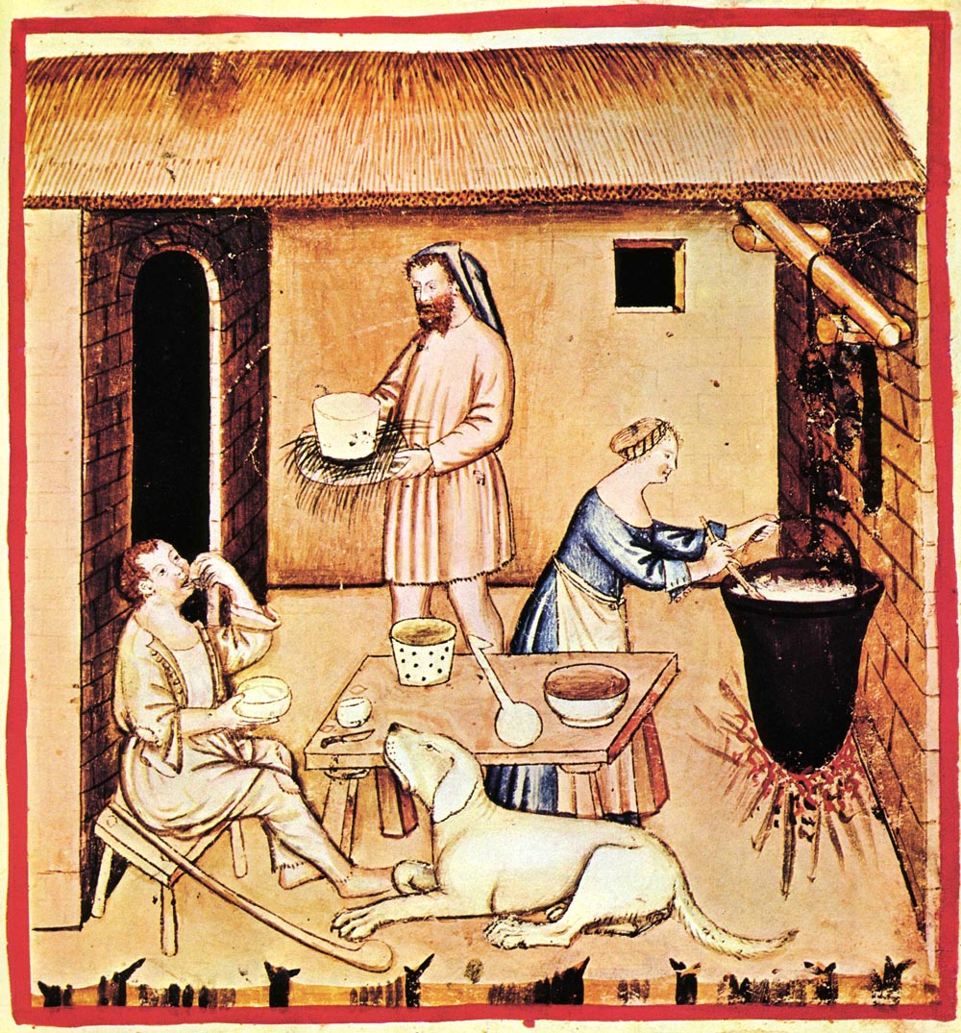
A History Lesson
Before
Rise of the SAN
The Great Reduction
StorSimple & Azure
Hyperconvergence
Banner 9
Now

Slide 4
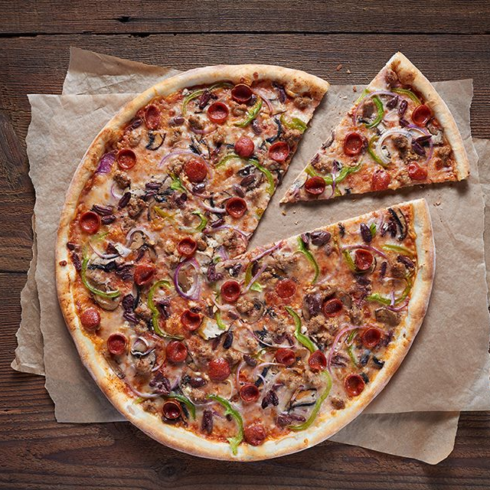
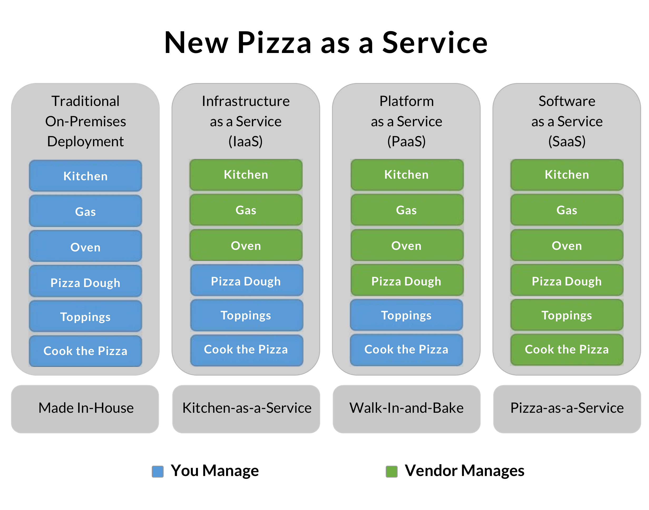
Pizza As A service
What does this mean to me today?
What could it mean for me tomorrow?
The Horizon

Slide 5
Three Table Legs
Notes:
Jon – Oracle -> Oracle in Virtualized Services box

Slide 6
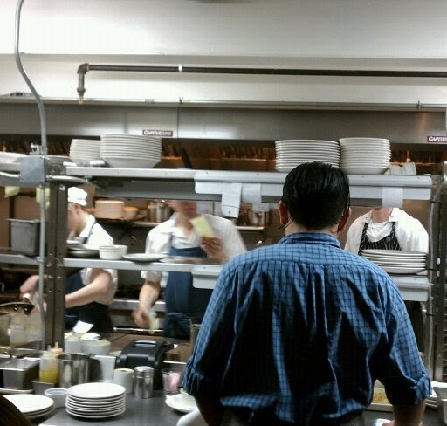
IaaS
A Web 2.0 way to say “VM”
This Photo by Unknown Author is licensed under CC BY-SA

Slide 7
IaaS at Western
VMs
Higher Ed Ecosystem
The “biggest” and potentially most costly of the methods of providing a service.
51% of our VMs are “Extra Large”
Requires the most maintenance and security
Dependance on many small requirements
Large, complex systems with multiple integrations provided by a vendor will land in this space
OnGuard, AiM, Oracle RDBMS, SQL Server, SCCM
Important systems that can provide services to other pizza stacks

Slide 8

SaaS
Just a slice

Slide 9
SaaS at Western
Today: Web Applications
Tomorrow: Azure Functions, IoT, Event Hubs
Higher Ed Ecosystem
ASP.Net, Tomcat, PHP
Single Serving Web Applications with “virtual” compute
Scalable, flexible and creative with a high degree of autonomy
Automated Scripts for general use
Many More Options as Western grows its understanding, familiarity and capacity
Under-developed space from partners – in some spaces
Wide-Open opportunities for “in-between” services, automation, ETL and data “shuffling” services
What is SaaS mean outside of Higher Ed?

Slide 10
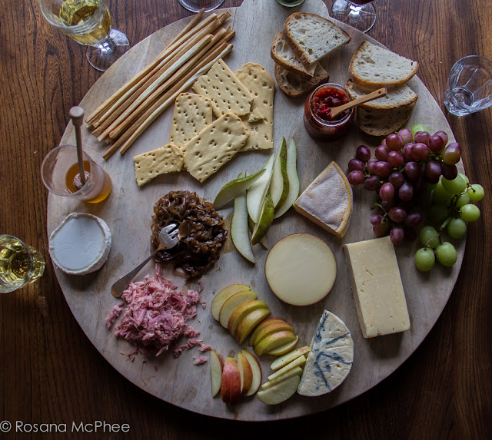
PaaS
All the SQL, None of the Server

Slide 11
PaaS at Western
SQL Services
Azure Kubernetes Services
Higher Ed Ecosystem
Uses our existing SQL Server Cluster
Automates the Creation of SQL Tables and Databases through the Azure Stack Hub Interface
A Pre-Defined Set of VMs
For Orchestrated Container Workloads
Not for Single Containers!
Separate Instances per workload, department and security
Dry Desert from Partner Spaces, especially on-Premise
Robust cloud offerings from Ellucian, Salesforce, and many partners
“Bring Your Service, use our platform”

Slide 12
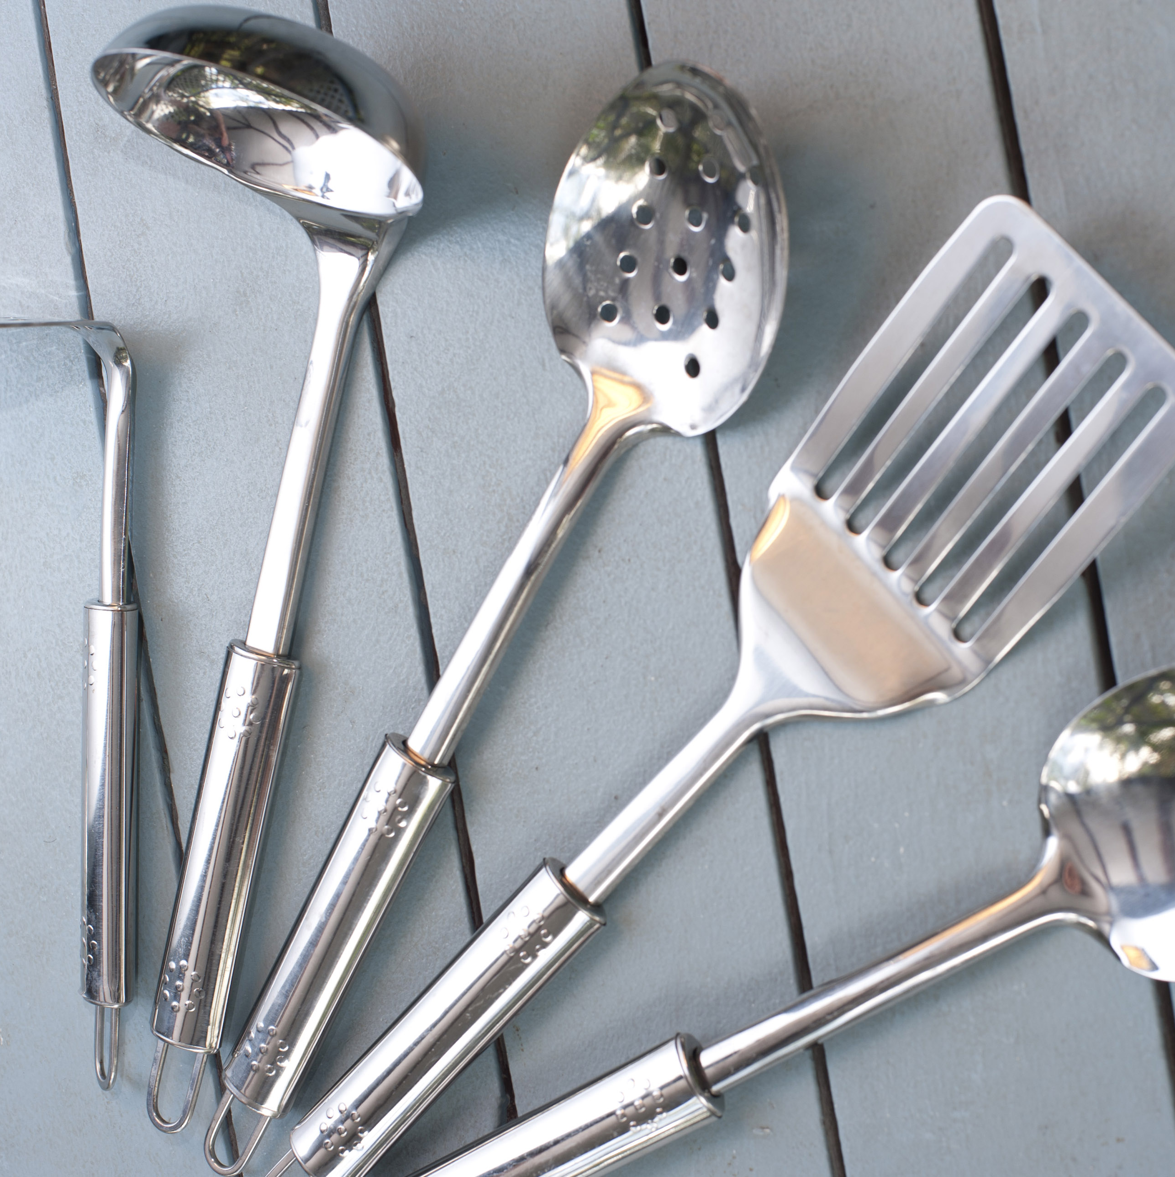
The way to get started is to quit talking and begin doing.
Walt Disney

Slide 13
Timeline
AKS Implementation for Banner
Kubernetes Services is the “Must Do” for this year
Re-Alignment
With the vacation of those services, it allows ITS to accurately size the next platforms
Testing Migrations
Where YOU come in, what’s your application upgrade cycle? When’s your next big release? Are you moving to the Cloud?
Production Migrations
Equipment Decommissioning
With the information we’ve gotten before and with your help, we’ll start the production migrations
We have hardware EOL in Feb of 2022, then in 2023 and 2024
These firmer deadlines will help inform what things need to happen “in the green”

Slide 14
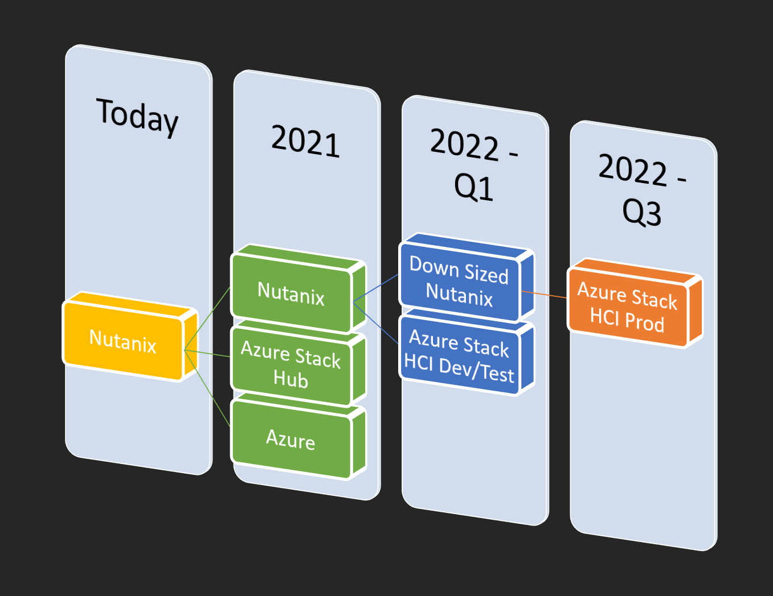
The Slide People Really Care about

Slide 15

Well, this is Wonderful….but
What do we need from you?
Dates!
Plans!
Ideas!
Do not worry! We have a form!

Slide 16
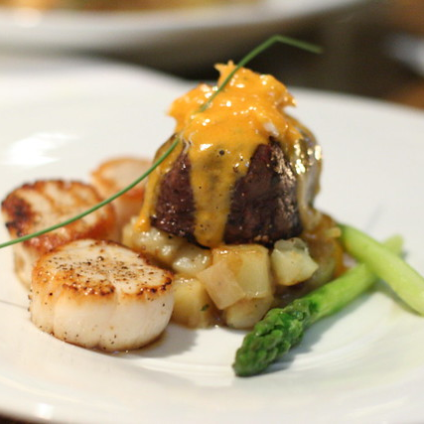
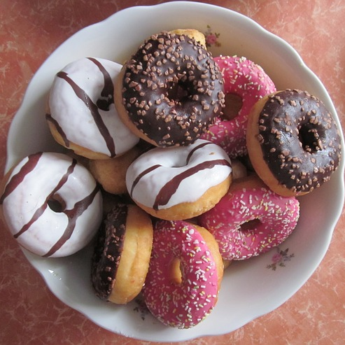
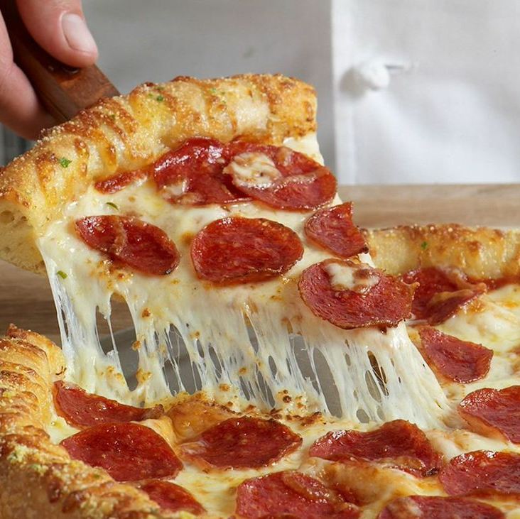
Summary
Your Partnership is important to this project
Your Communication is critical
We can bring significant improvements to the way services are delivered to our students and customers

Slide 17
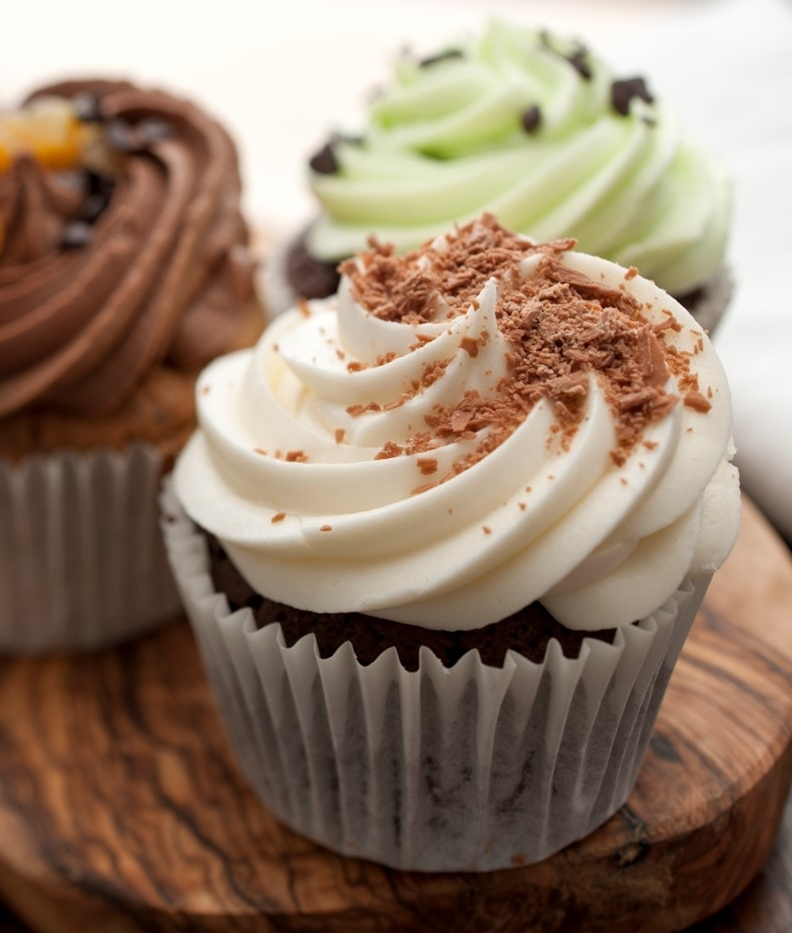
THANK YOU
Jon & Deborah

